Slide 1
Architecture Style in MAP
Architecture Styles are used by MAp to describe acceptable or preferred architectures. They are used to capture patterns, principles, and transformations. They apply across all viewpoints and concerns, and help define the language for architecture description. We see their application and value in all EAE architecture efforts: in ID&EM, SOA, GCIB, Roadmap Council etc.
In this short seminar we will discuss architecture styles in the context of MAp.

Slide 2
Outline
Basics
Jargon Defined
Spectrum of Styles
Connectors and Components
Styles and Goals
Examples: REST-ful services
The Logic of Style Templates

Slide 3
MAp Viewpoints
Information supports goals, process
Process supports goals
Domain / Biz
Architecture
1
Outside
Domain: Information, events
Goals
Process
Goals – success criteria
Black box assembly includes S,
Supports business model
Traceability
Mapped Black box Assembly (including S)
1
S
Component Architecture
Black box Spec (of S)
S
E
D
S
1
2
S: Information
Boundary
Architecture Styles: Principles, Patterns, Guidelines, Rules
Black-box Specification (of S)
4
S: Behavior
3
Black box view of S
Architecture styles, patterns: across viewpoints, projects
White box view of S
sub-component s1…s3
Partitions behavior & information
1
2
S
S
Component Architecture
White box design (of S)
s2
Inside
s2
s1
3b
s1
s3
3a
s3
4
Information
Behavior
Each sub-component could be drilled-down if needed

Slide 4
What is an Architecture Style?
Architecture Style: A definition of which architectures are acceptable (or preferred), in the context of goals and constraints, including a possibly customized language with new element types and rules of usage.
Possible usage includes design patterns, principles, idioms, shared code components, shared deployed instances, …

Slide 5
Outline
Basics
Jargon Defined
Spectrum of Styles
Connectors and Components
Styles and Goals
Examples: REST-ful services
The Logic of Style Templates

Slide 6
What is Architecture?
Architecture: An architecture of a system from a viewpoint is
  a (more or less correct) model of that system
  using the language of that viewpoint
  that describes system properties that are of concern to that viewpoint
    explicitly described in the model, or
    implicitly described via language-supported analysis of the model
Viewpoints are defined based on the kinds of questions they help answer
  Services Viewpoint: what services are provided and required? interactions?
  Deployment Viewpoint: where are deployable units run? what is connectivity?
  Production Viewpoint: how is system installed? migrated? administered?
  Viewpoint definitions are not dependent on specific systems
The language is associated with the viewpoint
  So all systems’ deployment architectures are described in the same language
Architecture captures key decisions and eliminates needless creativity in the further design, implementation, and evolution of the system

Slide 7
Example – Architecture and Language
slider
Button
position
pressed
<<prop>>
<<prop>>
limit
<<event>>
start
temp <<prop>> in
value
in
Thermometer
Threshold
<<event>>
stop
value
out
toggled
<<prop>>
in1
out
in
reactor
OR
Alarm
Switch
in
in2
gradient
out
Differentiator
in
Threshold
Components
Java
This is an abstract description of a running system
  it focuses on a viewpoint of logical structure, interconnection, and functionality
  it uses a language of components, properties, events, methods, and connectors between “ports”
What are some things explicitly answered by the model?
What things can be inferred by the model, given some specifications of the components?
There could be a corresponding Java implementation of this e.g. using Java Beans patterns

Slide 8
What is a Domain or System?
Domain / System: Some part of the world (as-is, or could-be) relevant to understanding or solving a problem
The “Domain” or “System” of interest could be any of:
  A software application or suite + relevant aspects of its environment
    The Risk Management Application
  A business unit or process + relevant aspects of its environment
    The overall Risk Management process, people, organization, roles, and policies
    The crisis_management phase of the overall Risk Management process
  A conceptual domain and its terms and concepts (ontology)
    The Risk Management domain
  A single software component
    The FX Exposure Calculator
  A collection of components and their intra- and inter-component interactions
    How the Policy Manager, Risk Calculator, and Hedge Manager collaborate
  A part of the platform, an infrastructure component
    Message Encrypter
The scope (spatial, temporal, aspectual) of a system shapes the models

Slide 9
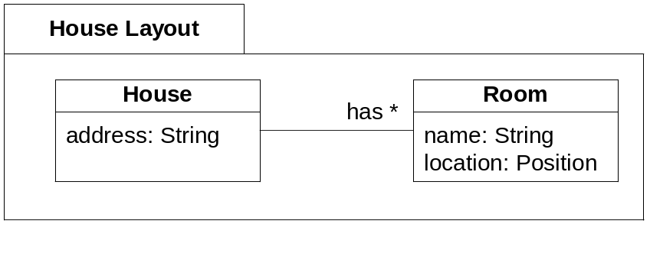

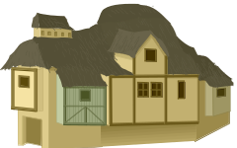
What is a Model?
Model: A structured description of selected properties of a domain or system, using some combination of formal modeling language and informal or natural language
house_layout.dtd
<!ELEMENT House (address, (Room)*)>
<!ELEMENT address (#PCDATA)>
<!ELEMENT Room (name, location)>
<!ELEMENT name (#PCDATA)>
<!ELEMENT location …>
house_layout.doc
House Layout
A house has an address and many rooms.
Rooms have a name and a location.
house_electrical.doc
House Electrical
A house has electrical runs.
Each electrical run has a load, start
device, end device, and path.

Slide 10
Notes about Models
Model ≠ Picture
Models include formal, semi-formal, and informal pictures, text, …
One model can include multiple diagrams, text, tables, …
There are many useful models of one system
A model is either a correct description of a system, or not
A model is expressed in a suitable language
The model can exist in many forms:
  paper with pencil
  a modeling tool artifact
  a word processor or xml document
  a white board
  spoken words
  in someone’s head

Slide 11
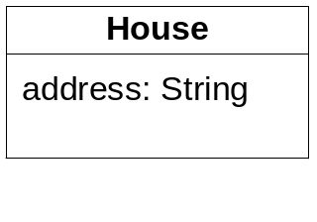
What is a (Modeling) Language?
Language: A collection of constructs (textual, graphical, etc.), rules to combine them into useful models, and rules to infer (validate, analyze, extrapolate, interpret, including about instances) from those models.
Class
Noun
Verb
Noun
class name
Attribute
“People drive cars.”
predicate
object
attribute name
attribute type
subject
Language: UML class model
Classes have a name and attributes.
Each attribute has a name and a type.
All class instances have values for those attributes.
An object’s data size is the sum of its attributes sizes.
Sentence
Language: English
Constructs and rules…
Language: Java …
Language: Korn Shell …
Language: Network Security …

Slide 12
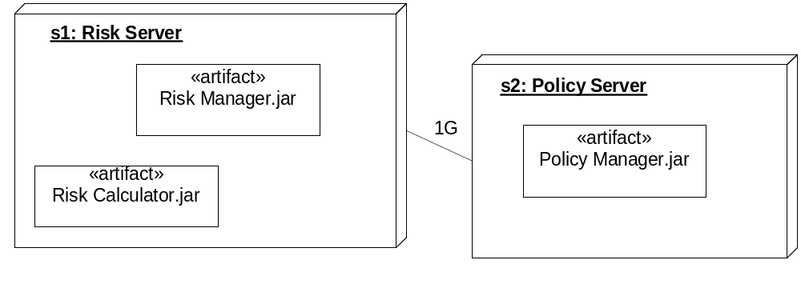
Language can be Concrete or Abstract
Nodes
s1: Risk Server
s2: Policy Server
Artifacts
Risk Manager.jar s1
Risk Calculator.jar s1
Policy Manager.jar s2
Links
s1:s2 1G
A language can be defined abstractly or concretely
Deployment – concrete pictures language
  Nodes are 3D boxes with <name> : <Type> in upper left
  Artifacts are boxes with «artifact» and <name>, placed inside their deployment nodes
  Links are lines between nodes annotated with bandwidth
Deployment – concrete text language
  Nodes: listed with “Nodes” and a list of <name> : <Type>
  Artifacts: listed after nodes with “Artifacts” and list of <artifact name> <node name>
  Links: listed after nodes with “Links” and list of <node>:<node> <Bandwidth>
Deployment – abstract language
  Nodes have artifacts deployed on them, and communication links with bandwidth

Slide 13
Languages and Models – One Size? Any Size?
Language
It is not advisable to
  Use widely different languages and vocabularies for similar purposes
  Prescribe an needlessly concrete language as a broad standard (colors? fonts? shapes?)
Recommended approach
  Standardize at least an abstract language for each major purpose
  Know how to interpret concrete variations in terms of that language
  Allow alternative presentations of the same model e.g. summarized, simplified
Models
It is not advisable to
  Build a wall-to-wall model with everything expressible about the system
  Describe any arbitrary bits of the system you want in any way you choose
Recommended approach
  Organize architecture as multiple viewpoint-oriented models
  Have standard viewpoints
  Have language associated with each viewpoint

Slide 14
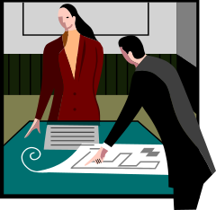

Composite Models and Languages – Consistency
Behavior
…transmit trade and settlement info to depository…
Information
Deals …
Parties …
Payments …
HVAC plan
Electrical plan
Home architecture
Services architecture
Positions of AC outlets and electrical devices
cannot overlap
All attributes referenced in behavior must be defined in Information
A model can consist of parts
  different pieces of structured diagrams and text, informal narrative
  even expressed in different languages
Various inconsistencies can arise because of this
  Within a model, or across two models that are composed together into a bigger model
So viewpoints and languages are potentially composite
  Must include consistency rules across sub-viewpoint and sub-languages
Hence an overall architecture is a composition of more focused architectures

Slide 15
Refinement – Architectures at different levels of Abstraction : From Goals to Code to Deployed Systems
Abstract multiple objects as a single larger-grained object or component
  From organizational units to software applications to fine-grained software objects
company
out
out
Zooming in/out – objects
Defer “internal” design of component
in
in
sales, accounts, fulfillment
Abstract a detailed interaction protocol into a single action
  At the level of entire business processes or software component interactions
buy
out
(b) Zooming in/out – interactions
Separate protocols, technical, UI specifics
in
order, deliver, pay

Slide 16
Architecture in Context
Architecture Styles
Architecture Styles
Knowledge
Experience
Patterns
Principles
Goals
Goals
Objectives
Problems
Needs
Requirements
Constraints
the problem
possible solution
solution approaches
lessons learned
Architecture
System
= The Enterprise
System
Running
Operating
In the Real-World
implement
conforms to, reverse engineer, test
The architecture of a system is a key determinant of whether or not a running system will meet business goals

Slide 17
Outline
Basics
Jargon Defined
Spectrum of Styles
Connectors and Components
Styles and Goals
Examples: REST-ful services
The Logic of Style Templates

Slide 18
SO … What is an Architecture Style?
Architecture Style: A definition of which architectures are acceptable (or preferred), in the context of goals and constraints, including a possibly customized language with new element types and rules of usage.
An architecture style can be described as:
  Guidelines and patterns for the architect to follow (generative)
    If high availability is needed use replication and heartbeats
  A generator or transformer of architectures (generative)
    Generate EJB deployment descriptors, database schemas from source model
  A predicate to use to check if an architecture is acceptable (not generative)
    Component count should be constant or increase very slowly with increase of users
Possible usage includes design patterns, principles, idioms, shared code components, shared deployed instances, …

Slide 19
Architecture and “Style” in MAp
Architecture Style
(patterns, rules, constraints)
Style
context
My architecture
Pattern 1
Pattern 1
Pattern 1
Rule 1
Apply Pattern 1 to every … when …
Pattern 1
Pattern 1
All architecture work is done in the context in some architecture style
An architecture style defines what set of architectures is acceptable
Style includes patterns, principles, constructs, usage rules, transforms, constraints
Developing and maintaining the elements of style is a key part of architecture

Slide 20
Architecture Styles – Spectrum of Creativity
Full defined rules
No ad-hoc at all
Only one solution “conforms”
A “design compiler”
No Rules
Fully Ad-Hoc
Any solution “conforms”
0%
100%
Creativity
Most common: guidelines, standard patterns, some rules, design language

Slide 21
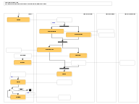
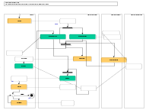
Architecture Principles and Styles
Architecture styles define rules of architecture conformance
Architecture styles define patterns of preferred or allowed architectures
One common form: Wherever you have … solve it by …
Very wide spectrum of styles in (and across) all viewpoints
  Business Process Style: Earliest point of data capture
    Wherever any process needs some information at multiple points …
    Capture the information at the first opportunity in process. Never require it again.
  Technical Architecture Style: MQ Series Configuration Style for Co-located Queues
    Wherever co-located components need a messaging connector …
    For a source S of events and a destination D that will be co-located on a single machine, use an MQ Series queue named <S><D><…>, configured as <….>, and set up the S and D ends of the queue as <….>
  Technical Architecture Style: XML encoding styles
    Use nested entities for …; use attributes for …; compress names as follows …
  Integration styles: point-to-point, desktop, gateway, …
Styles can be of more or less prescriptive and automated
  rules-of-thumb: if high availability is needed use replication and heartbeats
  review criteria: Component count should be constant or increase very slowly with increase of users
  fully automated transformations: generate EJB deployment descriptors, data model from source model
☑
☒
☑
☒

Slide 22
Architecture Styles can Span Viewpoints, Concerns
Architecture Styles
Module: build-time structure of software units including sources and tools
Location: deployment, location & connectivity: people, hardware, software, devices
Technical: technical and platform realizations of components, ports, connectors
Concerns
Performance: throughput, response time, latency, data volumes, loads
Security: who can and cannot do what and to whom
Business
Architecture Style
Logical Functionality: what actions with what information and what triggers
1. Business Architecture
Business perspective on the problem or concern, including goals, activities, interactions, and information.
Every business process must
do earliest point of data capture
Outside
Viewpoint
2. component architecture
– Black Box
Describe a large grained software component as a black box, with its behavior and information responsibility to others in its environment, for any aspect that is externally visible.
Boundary
Every web interaction
3. component architecture
- White Box
Design the “insides” of a black box component as a collection of connected sub-components, each a black-box, and decide how they collaborate to fulfill black box responsibilities.
White-box Architecture Style
Inside
Must follow this tech structure
Each style can be about just business, or white-box logical, or …
… or about correspondence or even transformations across viewpoints
Notes:
REVISIONS:
Add summary of UML diagrams used.

Slide 23
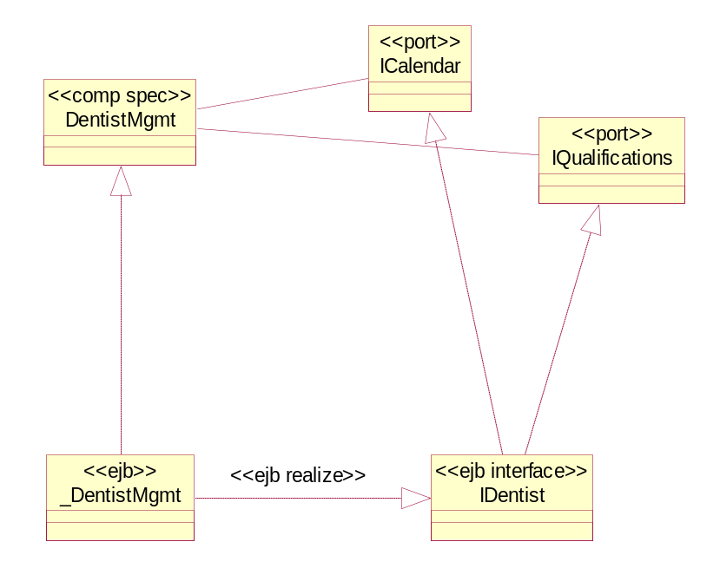
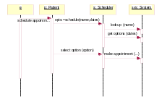
Preview of Technical Architecture
White (or black) Box Architecture
(component, ports, connectors)
Candidate patterns
Deployment architecture
Platform knowledge
Connector Realizations
Component Realizations
For each connector in white (or black) box
For each sub-component in white (or black) box
conn1
(a) Technical design of connector
(a) Data model for persistence
Roles
Application
Architect
Technical
Architect
Operations
Class and Interaction diagrams
Realization of ports, ops, events, names, exceptions, tiers, etc. to platform
Connector Realization styles
Patterns
Patterns
Or
(b) Connector styles applied
Patterns
Patterns
Component Realization styles
<<http>>
Or
(b) Patterns applied to map to component platform
Why do a Technical Architecture with connector styles?
Connectors repeatedly address similar connectivity and adaptation concerns. We want a consistent connector design and implementation. Sophisticated connectors decrease coupling between components. Consistent mappings from component specs to platforms help decrease needless variation.

Slide 24
Connectors and their Specifications
To use a connector in the white box assembly, we must know it’s spec
  Documented in a connector specification and used as a stereotype or pattern`
if no annotation, assume simple “call”
P1
P2
call connector
spec (trivial)
“<<out>> m1() call at P1 become in m1() call at P2”
«event-method»
P1
P2
event-method
connector
spec
“When P1 <<event>> e raised, the corresponding P2 method m() is executed
with event attributes mapped to method parameters
Using a connector means:
  connecting it to appropriate ports
  configuring it if necessary: e.g. which events to which methods, how to map attributes to parameters
It is possible to have richer connector types: synchronizing, replicating, etc.
Each connector type could have many different platform realizations
Platform realizations are described in Technical Architecture

Slide 25
Technical Realization of Logical Components, Connectors
White Box Arch
White Box Arch Styles
An event is specified by:
event name and event information
condition for event to be raised
An event method connector:
takes a raised event e (T)
takes a corresponding method m(x,y)
takes a mapping from T to x, y
ensures m invoked when e is raised
Facility Methods
Deal Mgmt
Deal Events
Facility Mgmt
«event-method»
Technical Arch Styles
To realize event S::e (T) in Java:
method S::add_e_Listener (x)
method S::remove_e_Listener (x)
call S::notify_e (T)
To realize method A::m (x, y) in C:
procedure m (A_id, x, y)
Map ids, parameter types: …
To connect Java event to C method:
add appropriate listeners
connect Java event to Java method
call C via Java Native Interface
Technical Arch
«Java»:
Events realized in Java event model
«C»:
Methods realized in C
Connect Java events to C methods
Map component spec to platform: methods → procedures? transactions? relational data?
Map operations, parameters, failures → platform naming, parameter types, exceptions

Slide 26
Example

Slide 27
Outline
Basics
Jargon Defined
Spectrum of Styles
Connectors and Components
Styles and Goals
Examples: REST-ful services
The Logic of Style Templates

Slide 28
Connectors Have Specification and Realization
Each connector is specified as follows
  Set of ports
  Properties, guarantees, and protocols between ports
Each connector has one or more realizations
  Realization of properties, guarantees, protocols on some platform
Connector definition can be layered
  One specification
  Multiple realizations
Example: Different ways to update destination attribute with source attribute changes
  Loosely coupled publish / subscribe mechanism
  Direct update calls from source to destination
1-way prop Connector
Spec
Propagate source attribute
to destination attribute
Realization 1
Use events with pub/sub
Realization 2
Use direct update calls

Slide 29
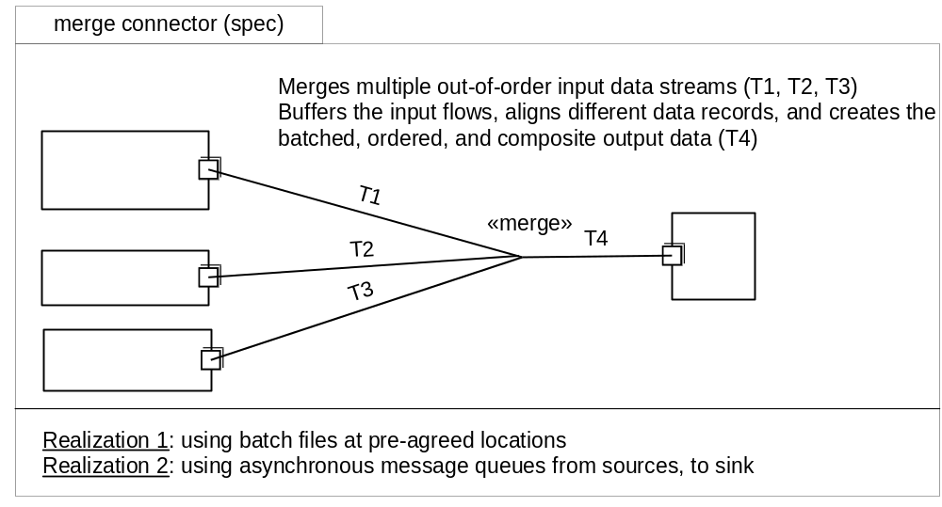
Sophisticated Connectors – Data Merge (Informal)
Note: sophisticated connectors enable us to use simpler approaches in white-box architecture e.g.
  Equality invariants across components → use property synchronization connectors
  Merge relationships across data collections or streams → use merge connector
  Event-trigger relationships across components → use event-method connector

Slide 30
Component Realizations Examples
Mapping patterns for components include
  Mapping of ports: single interface per component? Map ports accordingly
    E.g. Java allows multiple inheritance of interfaces; EJB has no outgoing ports
  Operation, parameters, and errors names and types
    e.g. Java exceptions
  Standard platform patterns
    e.g. home interfaces in EJB
  Component managers vs. Objects
    EJB requires a home interface which can serve some manager functions

Slide 31
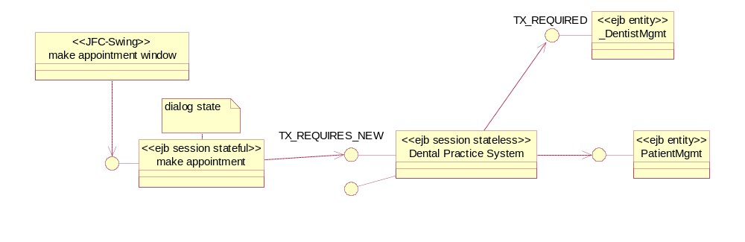
Mapping to Platform Architecture
use case operations
UI/dialog
Co-
ordinator
«core»
type
component
Guidance or rules of which elements of UI/dialog map to Swing and which to Session
UI/dialog
Co-
ordinator
Mapping of transaction properties to platform TX_REQUIRES_NEW
Can define patterns to map to platform supported architecture
  EJB Session beans (stateful for dialog; preferably stateless for server)
  EJB Entity beans
  Servelets and JSPs

Slide 32
Outline
Basics
Jargon Defined
Spectrum of Styles
Connectors and Components
Styles and Goals
Examples: REST-ful services
The Logic of Style Templates

Slide 33
minimize credit
risk exposure
Future Risk
maintain
act on
estimate
track historical
risk results
improve
estimation
model
estimation
model
Controllable future factors
loan portfolio
credit ratings
in-trouble loanees
historical
risk
estimation
performance
future risk
estimate

Slide 34
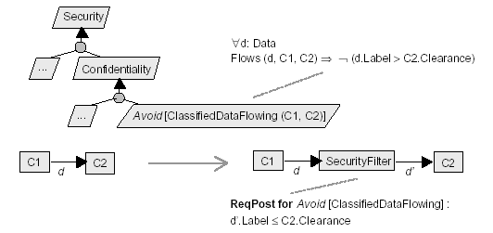
Example of Security Architecture Goal + Style
“resulting” security filter is specific
to C2’s clearance level
and C1’s data flow
This style
  has some preconditions on the architecture and goals
  makes a change to the component structure, flow, and security properties
  does not change the original functional behavior
  Extends the language (security attributes) and adds analysis (attribute propagation)
Commonly quality styles affect other qualities but not core functional behavior

Slide 35
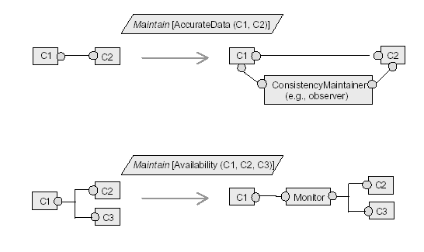
More Examples of Styles in Goal Context

Slide 36
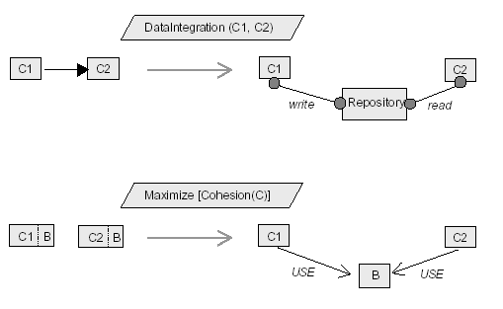
Still More Styles

Slide 37
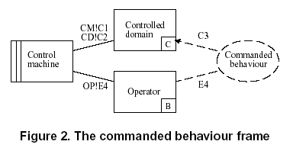
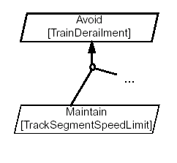
Refining Goals and Architectures
Michael Jackson
  Requirements ≠ interface specification
  Domains, shared phenomena
  One machine, requirements on machine
  Problem frames, composite frames
KAOS
  Goal-based requirements
  Agents, elements controlled and observed by goals
  Multiple agents, allocation of responsibility to agents
  Goal refinements and refinement patterns
MAP
  Refine goals
  Refine architectural components
  Joint goals and actions
  Refinement patterns
A
Rationale
X
Y
avoid(Z)

Slide 38
Outline
Basics
Jargon Defined
Spectrum of Styles
Connectors and Components
Styles and Goals
Examples: REST-ful services
The Logic of Style Templates

Slide 39
Style Example – REST
Representation State Transfer
(from Roger Costello slides)
Resource
Client
http://www.boeing.com/aircraft/747
Fuel requirements
Maintenance schedule
...
Boeing747.html
The Client references a Web resource using a URL. A representation
of the resource is returned (in this case as an HTML document).
The representation (e.g., Boeing747.html) places the client application in
a state. The result of the client traversing a hyperlink in Boeing747.html
is another resource is accessed. The new representation places the client
application into yet another state. Thus, the client application changes (transfers)
state with each resource representation --> Representation State Transfer!

Slide 40
The REST way of Implementing the Web Service
Service: Submit a Purchase Order (PO)
  The web service makes available a URL to submit a PO. The client creates a PO instance document which conforms to the PO schema that Parts Depot has designed (and publicized in a WSDL document). The client submits PO.xml as the payload of an HTTP POST.
HTTP POST
Web Server
PO.xml
conforms to.
PO.xsd

Slide 41
Submit PO Service (cont.)
The PO service responds to the HTTP POST with a URL to the submitted PO. Thus, the client can retrieve the PO any time thereafter.
  The PO has become a piece of information which is shared between the client and the server. The shared information (PO) is given an address (URL) by the server and is exposed as a Web service.
URL
HTTP Response
Web Server
PO.xml

Slide 42
Implementing the Web Services using SOAP
SOAP envelope
Request
(XML doc)
HTTP POST
URL 1
getPartsList()
Response
(XML doc)
HTTP Response
Request
(XML doc)
HTTP POST
URL 1
SOAP Server
getPart(id)
Response
(XML doc)
HTTP Response
Web Server
PO
(XML doc)
HTTP POST
URL 1
submit(PO)
Response
(XML doc)
HTTP Response
Note the use of the same URL (URL 1) for all transactions. The SOAP Server parses the
SOAP message to determine which method to invoke. All SOAP messages are sent
using an HTTP POST.

Slide 43
Note about the SOAP URI
It is not a SOAP requirement all messages be funneled to the same URL:
HTTP POST
getPartsList()
SOAP
Server
HTTP POST
URL 1
getPart(id)
submit(PO)
HTTP POST
However, it is common among SOAP vendors to follow this practice.
For example, here is the URL for all requests when using Apache SOAP:
[host]/soap/servlet/messagerouter

Slide 44
REST and Proxy Servers
Resource 1
Web
Server
Proxy
Server
Resource 2
http://www.somewhere.org/Resource1
“You’re not allowed
to access Resource 1”
Resource 3

Slide 45
Resource 1
SOAP and Proxy Servers
Web
Server
SOAP
Server
http://www.somewhere.org/soap-server
Proxy
Server
Resource 2
“I can’t determine
if the message is
allowed since I don’t
know what Resource it
is targeting [that
information is hidden
in the Envelope]”
Resource 3
<?xml version="1.0"?>
<soap:Envelope xmlns:soap="http://schemas.xmlsoap.org/soap/envelope/">
<soap:Body>
<getResource xmlns="…">
<id>R1</id>
</getResource>
</soap:Body>
</soap:Envelope>
Does this mean that the client
is trying to access Resource 1?
The proxy server must understand
the semantics of every SOAP
application!

Slide 46
Outline
Basics
Jargon Defined
Spectrum of Styles
Connectors and Components
Styles and Goals
Examples: REST-ful services
The Logic of Style Templates

Slide 47
Styles, Kinds, Levels, and Promotion
Styles can be of any granularity
Styles can be fully automated transforms, rough guidelines, checks, …
Styles can be built atop other styles (compose, extend)
Styles can be local to a project, to a department, or company-wide
Styles can have a lifecycle of maturity and promotion
v 0.8
v 2.0
Corporate
Project
v 0.2
mine

Slide 48
Check-Only Style
Style | Name of Architecture Style
Supertypes | Architecture Styles that this one specializes
Goals | Goal addressed by this style
Description | Description of Style using the general form: A [supertype style] which [properties of acceptable architectures which distinguish this style from other styles of the same supertype].
Attributes of architecture | attribute name | 1 or * | attribute type, description, derivation rule if applicable (Recursively define the types, using full information model of architecture concepts if needed, and/or refer to external definition and specialize as needed.)
Constraints | Constraint on values of attributes to tell whether an architecture conforms to style
Automated by | Which tool and/or tool configuration automates style checking, if any.
My Style
classes [*]: Class
root_component: Component
firewall: Firewall
Conforms?

Slide 49
Generative Style
Style | Name of Architecture Style
Supertypes | Architecture Styles that this one specializes
Description | Description of Style using the general form: A [supertype style] which [properties of acceptable architectures which distinguish this style from other styles of the same supertype].
Goals | Goal addressed by this style
Rationale | Reasons and tradeoffs made by this style
Attributes of architecture | attribute name | 1 or * | attribute type, description, derivation rule if applicable (Recursively define the types, using full information model of architecture concepts if needed, and/or refer to external definition and specialize as needed.)
Input Pattern | Constraint on architecture structural and other attributes for this style to be applicable
Output Pattern | Resulting architecture structural and other attributes after applying this style
My Style
input: Some_Stuff
result: Other_Stuff
classes [*]: Class
root_component: Component
firewall: Firewall
Conforms?

Slide 50
Transformer Style
Style | Name of Architecture Style
Supertypes | Architecture Styles that this one specializes
Tool | What tool to use to apply this style
Constraints | When to use this tool

